Slide 1


FreshDesk Proposal
For applications in the Open, Accessible Digital Workspace
November 1, 2018

Slide 2

New application strategy
Strategy for current and future OADW applications

Slide 3

Project Team
Genevieve Lemieux – product owner
Sierra Duffey - architecture, strategy and design
Marianne Aubrey – architecture, content and design
Ethan Wallace – client portal development
Marc D’Onofrio – primary client representative
Krista Lecuyer – secondary client representative
Digital enablement team – quality assurance, bot testers

Slide 4
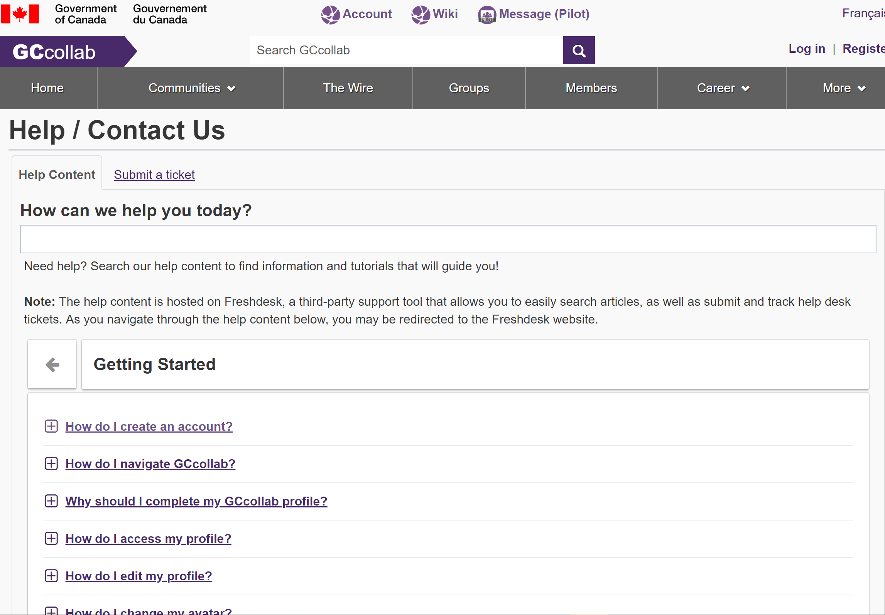
Current Situtation
Using API within apps for help content. We cannot see how many times an article is viewed using this method.
Cache needs to be refreshed in order to update this content.
Knowlegde base exists, but is difficult to navigate to.
Knowlegde base is outdated, and is based off of Legacy architecture, not the OADW suite.

Slide 5
Why should we update Freshdesk and our Knowledge Base?
Reduce tickets and workload for the help desk agents
Users are more likely to find the solution without having to involve an agent
Improve user experience of the Tools overall
The more quickly a user is able to find a solution, either through their own means or help desk, the greater their satsifaction.
Reflect the new OADW
As our product moves towards a suite of tools vs monothic tools, we will need to have our help content reflect that change.
Notes:
Reduce tickets and workload for the help desk agents
Help desk receives many tickets which are answered in existing articles, and the agent will link the article to the user.
This increases the workload of the agent, and pulls them away from addressing more complex issues.
The user may also be frusturated by the process and turn-around time of submitting a ticket, especially when they could find the answer to their question themselves.
Improve the user experience
Users may also be able to use the Tools more fully with better, easier to find and navigate help content
Reflect the new OADW
Branding: Using Aurora design system, we can have our help content be inline with the design of our upcoming Tools

Slide 6
Why should we start work a Freshdesk update as soon as possible?
Saves time and effort
Addressing an update now will eliminate the need to go back and make changes as we continue to rebuild
Smooths the transition to the OADW
Users who use the help content will introduced to the concept and design of the OADW earlier
Improves the image of the GCTools
Users who are able to find the solution to their problems by themselves more quickly will precieve the Tools as being more usable.

Slide 7
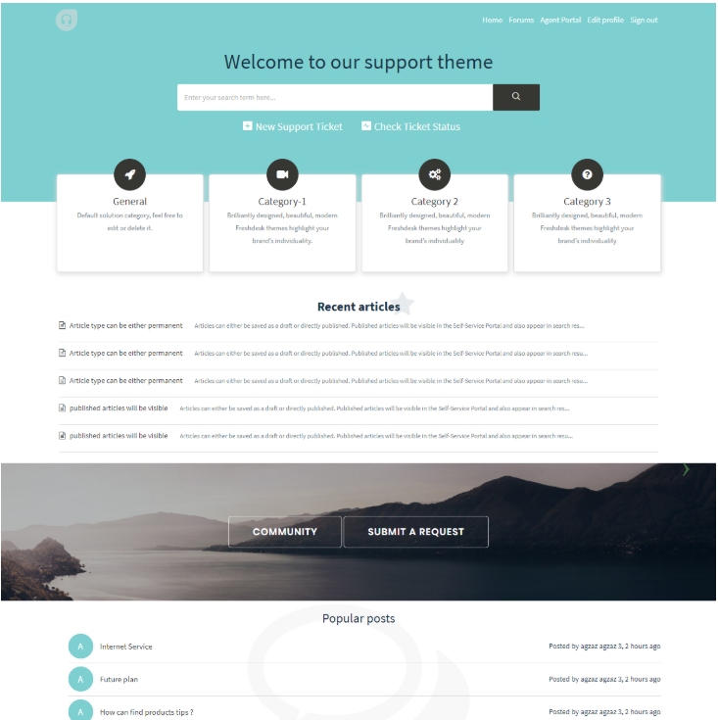
Single client portal
Help icon in common navigation, and other links would open this portal in a new tab. Custom URL as help.gcollab.ca
UI features: prominent search, product-based breakdown, link to ticket submission, can apply Aurora styling
Customization based on an existing FreshTheme (e.g. on the right)
This particular theme is free, we will just need to add attribution in the page header https://helpdesktheme.com/downloads/vertio-freshdesk-and-freshservice-theme/
Can customize with Liquid/HTML as needed, including category icons
Notes:
Will need to determine if still compatible with single sign-on
Will need to remove Forum-related elements and replace with other content.
May require additional identifiers (common nav, FiP elements, Aurora/OADW branding elements)
Custom portals use Liquid markup, an extension of HTML and CSS used for creating themed pages (from Shopify)

Slide 8
Proposed architecture
Open, Accessible Digital Workspace
About
Aurora design system (not shown in categories on home page)
Career
Account
About Aurora
Registration and login
Folders TBD
Navigation and search
Security and privacy
Applications (one article for each product with key info)
Development and contributing
Project management
For developers
For designers
Account settings
Notes:
Speaking notes:
All of the above boxes are separate products, while text in black represents folders within those products.
All of the products will be available in the overall OADW portal
Each product will appear as a category on the client portal home page. And each of these icons/descriptions will lead to that product’s knowledge base.
Individual articles will also be appropriately tagged and placed in correct folders and products. Some articles may cover more than one application, so will need to go with product that makes the most sense from the user’s perspective, but will have tags for all other relevant applications
Architecture created from the user’s perspective and taskflow. Even if an article or feature technically falls under one application, it will appear in the knowledge base as it is perceived by the user. Perception is key.
**** NOTE ABOUT PERCEPTION HERE. It is everything. How would the user ask the question? Where would they expect to find the answer? In their mind, what functionalities falls under a certain application? Technical structure has no relevance here.
Account settings needs review for additional content
OADW, applications. One page with key selling points. Will outline key features, technologies used, cost (free) and access levels (what account is required, internal, external etc.) Will provide a link to the application, as well as that specific knowledge base product. “Learn more about…”

Slide 9
Proposed architecture (cont’d)
Collab (current state)
Getting started
Message
Wiki
Profile (current state within Collab)
Profile basics
About
Getting started
Content management
Collabortion and networking
Frequently asked questions
Group ownership and management
Widgets
Sending messages
Getting started
Navigation
Editing and contributing
Notes:
Speaking notes:
All of the above boxes are separate products, while text in black represents folders within those products.
All of the products will be available in the overall OADW portal
Each product will appear as a category on the client portal home page. And each of these icons/descriptions will lead to that product’s knowledge base.
Some products, depending on size, functionality or complexity of the application may not warrant enough help articles to need multiple folders.
Individual articles will also be appropriately tagged and placed in correct folders and products. Some articles may cover more than one application, so will need to go with product that makes the most sense from the user’s perspective, but will have tags for all other relevant applications
New version of profile TBD, but proposed folders would be profile setup, teams and supervisors
Wiki and Collab should have more consideration, IMO FAQ is a lazy way to say uncategorized. Everything should make sense from user’s perspective and ultimate goals.

Slide 10

Full information architecture
Work in progress, with comments and proposed folder structure.
https://gccollab.ca/file/view/1405995/enknowledge-base-information-architecturefr

Slide 11
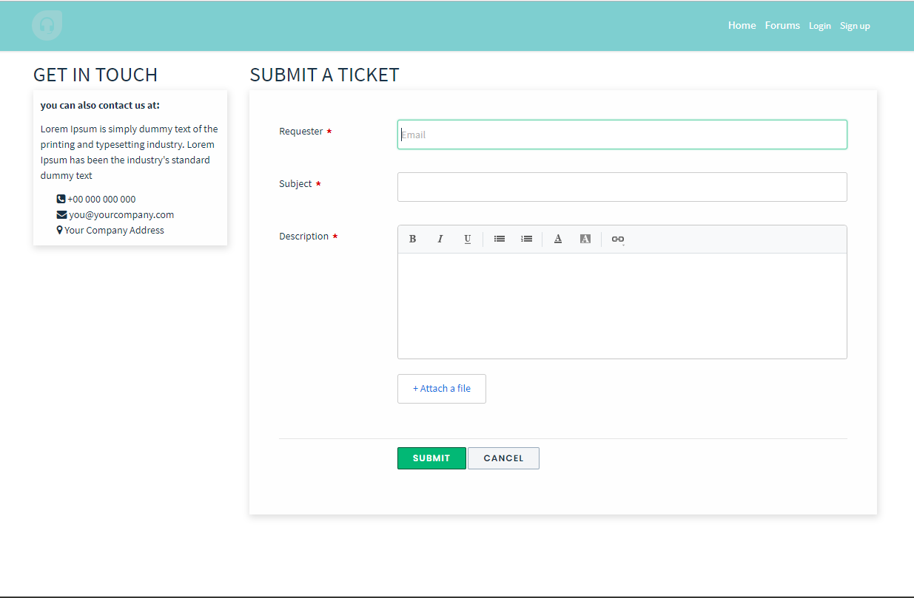
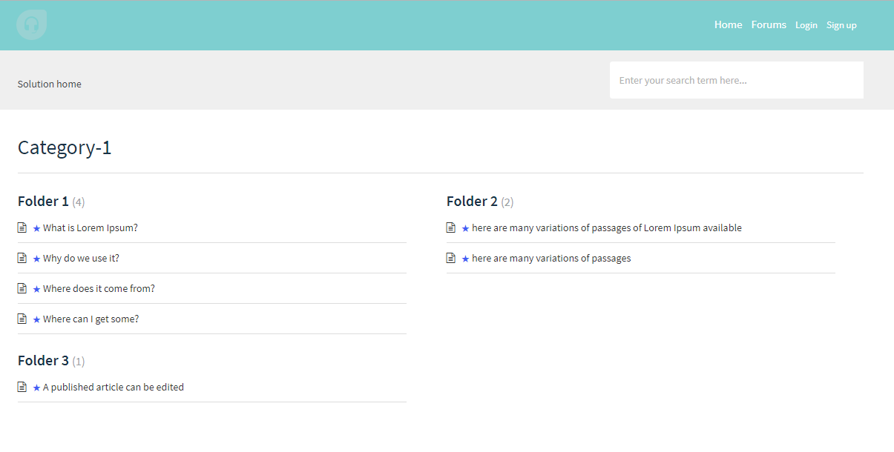
Benefits for the user
Consistent help experience across applications
Emphasizes structure and concept of the eco-system of applications, visually and conceptually places them together through the help system
Makes it clear that this is the help desk for OADW applications, and not other IT-related services in GoC. (OADW branding)
All pages throughout the workflow can be customized and styled, users will know that all pages are still related to OADW help
Divides articles in logical categories – applications as seen from the user’s perspective
Promotes self-help prior to submitting tickets. Search is the most prominent function

Slide 12
Legacy Tools
Keep current structure for Legacy tools, including interface directly on the platform and API calls to knowledge base articles
Won’t allow for rich data collection on knowledge base articles
Keeps user experience consistent for existing users who are familiar with the current ticketing process
Won’t make any changes to agent’s process for responding to users on the legacy tools

Slide 13
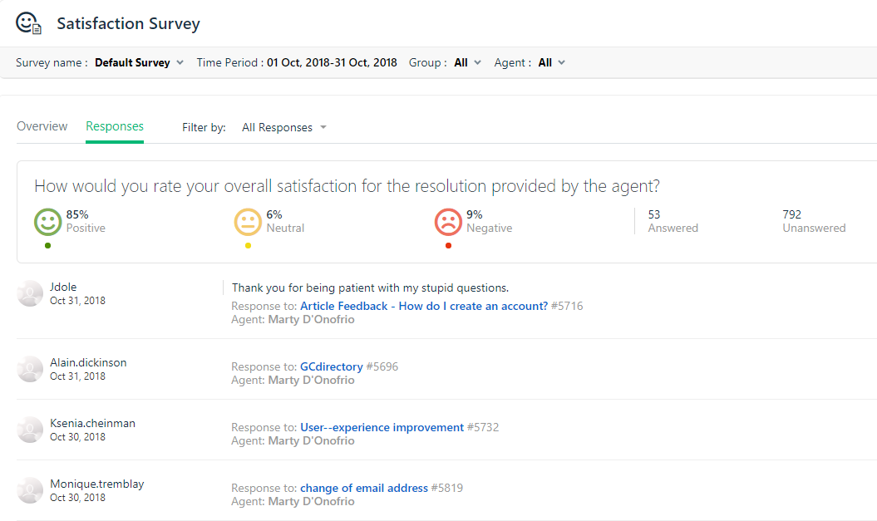
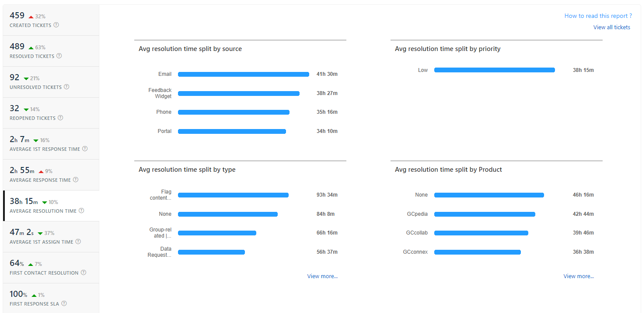
Key Analytics
Can schedule up to 5 report exports to be sent to email.
New portal will allow for accurate views on help articles, as well as more visually prominent place for clients to provide feedback on individual articles.
Key analytics from in-depth report: Created tickets split by product, Created tickets split by type, Unresolved tickets split by product, Unresolved tickets split by type, Reopened tickets split by type, Avg resolution time split by type, First contact resolution by type
Satisfaction survey responses
Notes:
These analytics will help us determine gaps in functionality or knowledge base. Can create or improve articles in these categories.
Will be able to determine which products receive the most help requests.
Will show which types of tickets are most difficult – need to be reopened or have longer response times.
Explore new ways to encourage users to complete a satisfaction survey – can create a custom survey to ask about any articles they may have accessed, include link to satisfaction survey directly in emails.

Slide 14
Proposed Timeline (3 sprints)
Sprint 51:
Create new admin portal + product/folder structure for OADW applications
Determine requirements for custom portal pages
Review ticket and feedback forms, determine changes
Determine articles required for new applications / OADW
Refresh contact /agent information
Sprint 52:
Download portal theme and customize styling and layout to meet requirements
Write and translate portal text
Write new knowledge base articles
Update ticket and feedback forms
Onboard new Freshdesk agent through courses and blogs
Ongoing:
Write new knowledge base articles as needed
Review analytics to determine which articles may need updates
Regularly Review efficiency and accuracy of AI bot
Set up scenarios and ticketing templates
Sprint 53:
Testing and final adjustments to client portal
Review tags and article properties
Transfer existing OADW application articles to new folder structure
Set up scheduled analytics reports
Set up and train AI bot
New article translations
Notes:
3 sprints may be ambitious, but does not include writing all new Freshdesk articles – just creating structure!
Testing will continue past sprint 52, and portal and AI bot will likely be enabled for users after one or two sprints of testing.

Slide 15

Smart support bot
A machine-learning bot that will help answer
tickets using our knowledge base content.

Slide 16
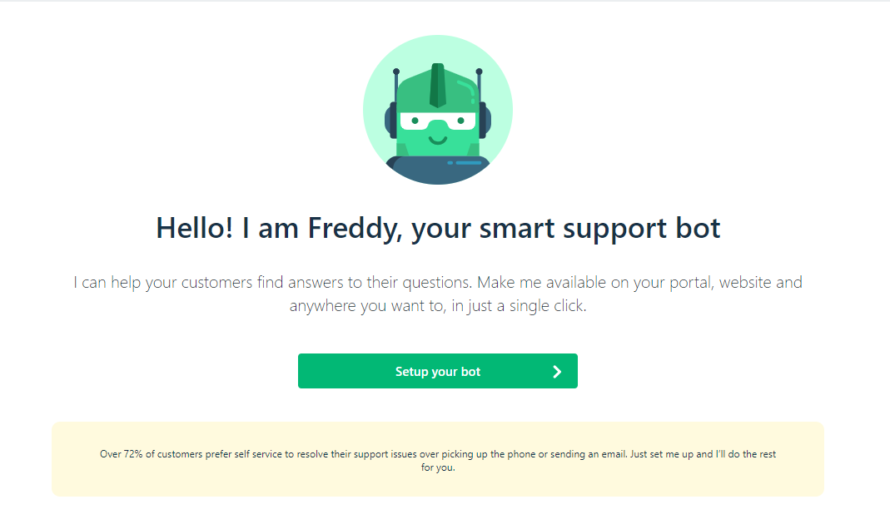
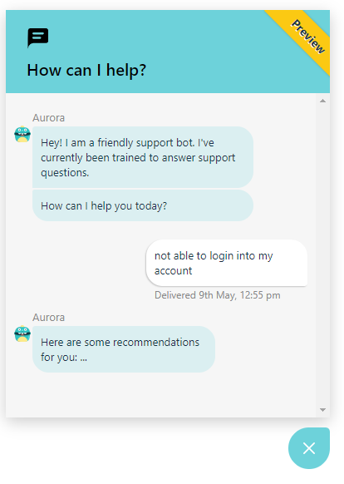
Bot Setup
Will require robust knowledge base with at least 50 articles and organized structure
Set up through Admin panel on Freshdesk
Can customize bot avatar, name, widget colour, header text and size
Choose article folders for the Bot to draw from
Once enabled, appears on client portal
Start asking questions, and train your bot to answer using specific articles
Get members of the team to start testing the bot on client portal prior to enabling for users
Can also be added as a widget on specific applications or common nav.

Slide 17
Considerations
Pros
Cons
Faster responses, particularly for common questions and issues
Will filter out issues that are easily answered through knowledge base articles
Automation. Will allow for faster processing and less ticket load for agents
Agents have more time to focus on complex tickets, Freshdesk analytics, writing articles and canned responses, Freshdesk strategy, etc.
Accuracy of responses may be an issue
Misinformation, inaccuracy, or broken responses
Is dependent on a strong knowledge base structure
Users may be frustrated with extra layer before communicating with a real person
Will need regular review to determine if bot is actually beneficial or hindering client experience or agents’ processes

Slide 18
Other considerations
More features, considerations and useful
updates discovered during research.

Slide 19
Freshdesk features
Custom customer satisfaction surveys and feedback forms.
Linked tickets
Shared ownership on tickets
To-do reminders
Annotations on image attachments
Customer journeys – Freshdesk can show the last 5 articles a client read before submitting a ticket (if they used the actual portal page)
Shortcuts for canned responses or repeated actions

Slide 20

Easier ticketing
Ticket templates for common questions and issues such as password resets, GCcollab invitations, etc.
Provides easy ticketing on the client-side, and more consistent tickets to ease sorting, filtering, assigning etc.
Scenarios, quick clicks to perform certain actions on tickets.
Ideas: feature requests, bugs, communications questions, data requests, password resets/duplicate accounts, GCcollab invitations,
Notes:
Point here is that we should put some thought into common questions, issues and scenarios – and automate as much as possible. Allows agents more time to review processes, help users with more complicated questions, adjust and improve on knowledge base.

Slide 21

Additional Resources
Smart Bot support
FreshTheme Guide
Customer Journeys
FreshDesk Academy
Freshdesk Knowledge Base
FreshDesk Blogs
Freshdesk Community Forum
List of free Freshdesk Themes
Agent Guide

Slide 22

Thank you!
For more information, please visit https://support.freshdesk.com/support/home
Sierra Duffey,
Web Content Specialist
sierra.duffey@tbs-sct.gc.ca
(343) 548 – 3306
Marianne Aubrey

